Slide 1

Updates
Michelle Nienhius, MPH
Manager, Division of Prevention and Intervention Services
August 4, 2022
Notes:
Custom DAODAS color codes is : Red-0
Green-131
Blue-139

Slide 2
Topics Addressed:
CTC Reports
Synar/STEP
PREP
TEP
Training/Resources
FY23 Funding and Compliance Contract and Prevention Services Manual
Overdose Prevention
Grants Management System

Slide 3
CTC Reports were emailed out earlier this week.
The State report will be revised in the upcoming weeks and sent back out due to some additional data that needs to be analyzed and added to the report.
Once the State report is finalized, the report will be posted on DAODAS website and the SC Documents website .
In a few weeks, additional factsheets highlighting each drug category’s stats on usage, perception of risk, accessing, etc. will be available as well.
Start planning now for the next round which will occur in the Spring of 2024.
Planning will begin in Spring of 2023 and recruitment materials will be made available before August 2023

Slide 4
Synar Reimbursements for the FY22 study were sent out in early July. 28 out of 46 counties did not earn the bonus
In order to receive this money, all of the following guidelines must be met:
Complete the Relias Training for two people per agency and submit certificate of completion to DAODAS by deadline posted for each group.
Group 1 must inform DAODAS by October 29, 2021 if any outlets are ineligible. Group 2 must inform DAODAS by February 25, 2022 if any outlets are ineligible.
Purchase attempts must be completed by January 21, 2022 (Group 1) and May 13, 2022 (Group 2). Counties must have attempted a purchase at all eligible outlets provided to them for the study or documented that the outlet is ineligible. If you are requesting an extension due to COVID, you must submit request in writing to DAODAS by January 7 (Group 1) or by May 6 (Group 2).
All required information, forms, and data must be returned to the state Synar staff by February 4, 2022 (Group 1) and June 3, 2022 (Group 2). Forms must be fully and correctly completed. Please do not fax. If you are requesting an extension due to COVID, you must submit request in writing to DAODAS by January 7 or by May 6.
Purchase attempts must be done with an approximately equal balance of males/females and 15, 16, and 17 year old’s. The race of the buyer for the purchase attempt should match the demographics of the community.
All inspections were conducted according to protocol as documented by state Synar staff

Slide 5
SYNAR and STEP Program Overview
The study timeframe will take place between November 1, 2022 – January 20, 2023 or March 1, 2023 – May 12, 2023. This is dependent upon which group you are in.
  Region 2 and 3 are November 1, 2022 – January 20, 2023. If you are requesting an extension due to COVID, you must submit request in writing to DAODAS (prevention@daodas.sc.gov) by January 6, 2023. Paperwork must be mailed (postmarked) to DAODAS by February 3, 2023.
  Region 1 and 4 are March 1, 2023– May 12,2023. If you are requesting an extension due to COVID, you must submit request in writing to DAODAS (prevention@daodas.sc.gov) by April 28, 2023. Paperwork must be mailed (postmarked) to DAODAS by June 2, 2023.
Regions 2 and 3 will need to complete the Annual Synar Study training on Relias between October 10 – 31, 2022. More information to come
Regions 1 and 4 will need to complete the Annual Synar Study training on Relias between January 17th and February 24, 2023. More information to come
Synar Manual will be updated and placed on SC Documents website: https://ncweb.pire.org/scdocuments/ by September 30, 2022

Slide 6
SYNAR and STEP Program Overview
Synar Tobacco Enforcement Partnerships (STEP)
The SC STEP program is an incentives based program that incorporates current aspects of our state’s prevention system, the Synar study, merchant education, and mandated county tobacco compliance checks, with federal mandates and other tobacco control and enforcement initiatives, the Synar coverage study (federal requirement) and tobacco strategy incentives. (i.e., Tobacco Education Program, Point-of-Sale work, and Multi-Jurisdictional Law Enforcement Agreements).
The intent is for the STEP program to package tobacco enforcement best practices and requirements and provide financial incentives to encourage the use of best practices at the local level.
Each year, a portion of the Substance Abuse Block Grant (after the costs are reimbursed for the Synar study and bonuses) is divvied up and allocated based on the STEP-approved activities completed in each county.
Payments for this past fiscal year were issued in early July.
Total points earned: 200.5 Total per point: $191.70
Total amount provided in incentives: $38,435.85

Slide 7
SYNAR and STEP Program Overview
Counties can earn STEP points for some or all of the following efforts:
• Conducting tobacco compliance checks,
• Reporting new tobacco outlets and cleaning their list frame,
• Merchant Education,
• Tobacco Education Program,
• Point-of-Sale Taskforce development,
• Merchant Pledge(s),
• Establishing multi-jurisdictional law enforcement agreements around tobacco.
Please use the following designated STEP email address to ask DAODAS questions regarding STEP: daodas.stepprogram@daodas.sc.gov
Additionally, all templates, forms, and the new STEP Cover Sheet are on the SC Documents webpage: Search STEP

Slide 8
PREP Reminders
Revisions have been made to the PREP curriculum
Regions 1 and 2 had a TOT training last week for current trainers to introduce updates.
Regions 3 and 4 have trainings upcoming
All materials are on DAODAS website: https://www.daodas.sc.gov/services/prevention/merchant-initiatives/
PREP Training Materials- this is a password protected site
Password will be provided via email once staff members complete TOT
Translation of participant manual is underway. Mad Monkey has provided DAODAS with the videos to include the Spanish translation option in closed caption.
https://youtu.be/K70bG48EEL8

Slide 9
Tobacco Education Program (TEP)
Statewide committee met at end of July to begin discussing updates to current curriculum
Take Survey today for committee to have your input
Committee will continue to meet over the next few months to update the curriculum
Goal is to have curriculum updated before end of calendar year

Slide 10

REGISTRATION:
http://npnconference.org/registration/
Regular Registration: $350

Slide 11
Alcohol Policy 19: Building a Framework for Change
Alcohol Policy 19/AP19 Conference
Changed to September 14-16, 2022
Renaissance Arlington Capital View Hotel
Register Now
The 19th in a series of conferences on preventing and reducing alcohol-related problems using public policy strategies.
​
Important Dates Early Bird Registration is now open through May 31, 2022 Advocate Institute Registration is open through September 9, 2022 Full refunds are available through February 28, 2022 Partial refunds (50%) will be available between March 1, 2022 and July 31, 2022
We are excited to see you all in September - be sure to register now to secure your spot!
For additional information on hotel, important dates and more, please visit the AP19 Conference website.

Slide 12

https://nllea.org/Event/Registration?id=15
Conference registration for NLLEA members is $500.00 and includes: Day One: breakfast, lunch, snack and dinner
Day Two: breakfast, lunch and snack Day Three: breakfast (1/2 day). Registration for non-members is $650.00,

Slide 13

The National Emerging Drug Trends Conference is an exclusive drug education, prevention, and enforcement conference, highlighting an array of superior speakers with expert knowledge.
Join us in Dallas, Texas on October 7th and 8th of 2022!
https://www.emergingdrugtrends.com/
Registration Fee: $450.00 before August 13th

Slide 14
FY 23 Funding and Compliance Contract and Prevention Services Manual
Executive Director should provide a copy of the contract to the Prevention Director
Prevention Services Manual has been updated for FY23 and the revised copy will be placed on the SC Documents website
SAPTBG Primary Prevention Set Aside formula was updated for FY23 to reflect 2020 United States Census data.
Reminders:
All full- and part-time employees delivering prevention services shall have a period of 36 months from their permanent date of hire to obtain prevention certification through the South Carolina Association of Prevention Professionals and Advocates. The certification timeline allows agencies to include a probationary period, not to exceed six months, if they desire.
All prevention professionals must have a training plan for obtaining and maintaining certification. This plan must be updated annually.
All prevention staff shall attend the Substance Abuse Prevention Specialist Training (SAPST) within two years of their hire date.

Slide 15
FY23 Reminders (cont.)
A key element for ensuring that the highest-quality prevention services are provided to all South Carolina citizens, organizations funded by DAODAS through the Substance Abuse Prevention and Treatment Block Grant (SABG) shall obtain and maintain national accreditation by either the Joint Commission or CARF International for their primary prevention programs that target children, youth/adolescents, and adults.
Each agency shall have at least one representative attend the Prevention Quarterly Meetings that are held by DAODAS on the first Thursday (unless notified of a change by DAODAS) of the following months: August, November, February, and May.
It is the responsibility of the agency to send to DAODAS a revised Prevention Staffing Capacity Plan if there are any personnel changes, staff funding changes, etc., that occur throughout the fiscal year.
Prevention providers are required to use the DAODAS Standard Survey (provided separately) as an evaluation tool for any multi-session education program aimed at youth ages 10 to 20. This applies to research-based and non-research-based programs. Program exceptions for the use of the DAODAS Standard Survey are noted and defined in the South Carolina Prevention Evaluation Handbook. There is a paper and online version of the survey available.
**These are just a few highlights from the Manual, please read the entire document and contact DAODAS with any questions.

Slide 16

INFOAMTION OPIOID OVERDOSES: Suspected Opioid Overdoses Preliminary Data for June 2022
Total incidents were 9% lower than the previous month. Suspected opioid overdoses are 12% higher year to date compared with 2021.
Other trends to note:
Although suspected opioid overdoses decreased from the previous month for most demographics, opioid overdoses were level with the previous month among ages 18-34 and 65+ and increased 40% among other races (Hispanic ethnicity).
Of the state’s six High Intensity Drug Trafficking Area (HIDTA) counties, Horry, Greenville, Charleston, Richland, and Lexington were in the top 10 counties by number of suspected opioid overdoses in June 2022. Horry and Greenville were also in the top 10 for rate per population for three consecutive months.
Most counties experienced fewer overdoses than the previous month. Of counties in the top 10 for rate per population, Aiken and Horry experienced more overdoses than in the previous month.
Christina Galardi, MPH, MCRP
Public Health Analyst
CDC Foundation
Preliminary Data For Informational Use Only-Published July 19, 2022

Slide 17
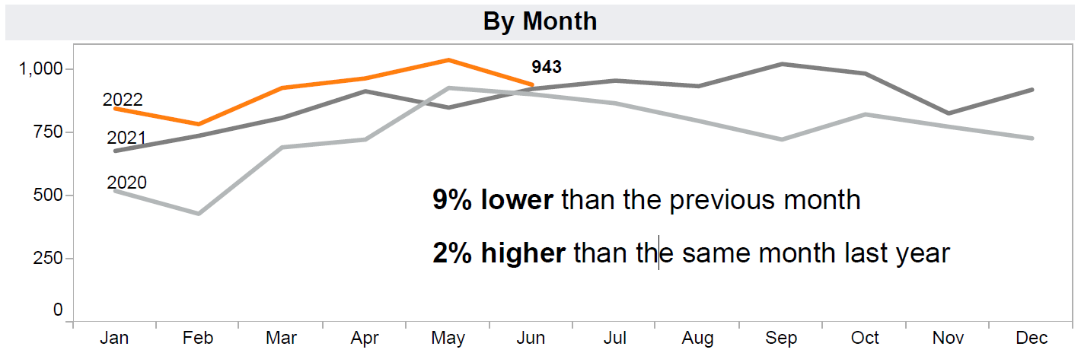
Preliminary Data For Informational Use Only

Slide 18
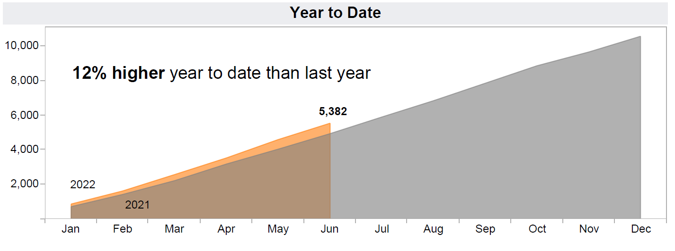
Preliminary Data For Informational Use Only

Slide 19
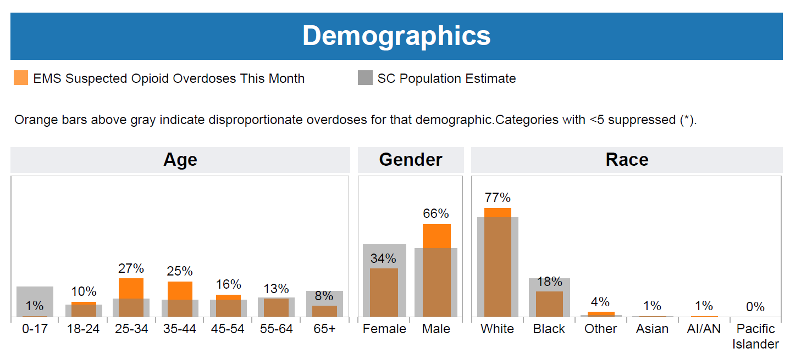
Preliminary Data For Informational Use Only

Slide 20
Overdose Prevention Updates
Narcan- 67 respondents as of 8/3/2022
Fentanyl Test Strips- 140 respondents as of 8/3/2022
Tips for enhancing our survey participation recommendations:
Ensure that each recipient gets the following instructions regarding the surveys by all staff who distribute Narcan or FTS (including those distributions that occur in outreach settings):
  Inform recipients the survey is very brief and completely anonymous (cannot be tracked)
  the survey is an important feedback tool to ensure your agency can continue to offer them Narcan and/or FTS at no charge because it provides proof the programs work by those that use them
  Discuss all access points to get to the surveys and inquire which method might be the easiest for the recipient. They may reveal to you that they don't want to use their phone and/or they don't have a phone or a computer etc. Ensure they know that they can use your agency iPad to complete the survey.
  Let them know that they will be asked by staff upon return for more FTS or Narcan, about their participation in the survey and encouraged to complete it onsite if they haven't completed it yet.

Slide 21

National Fentanyl Prevention and Awareness Day: August 21, 2022
https://facingfentanylnow.org/
WHY AUGUST 21? National Fentanyl Prevention and Awareness Day™ is August 21. The date is chosen not to overshadow the importance of Overdose Awareness Day that falls in the same month, but as a perfect time to bring attention to the differences between "overdose" and poisoning.
BE A VOICE FOR CHANGE
Contact us if your organization wants to be involved in bringing attention to the National Day. We will include your organization link to our website. If you are an interested spokesperson, we would love to hear from you and disc

Slide 22
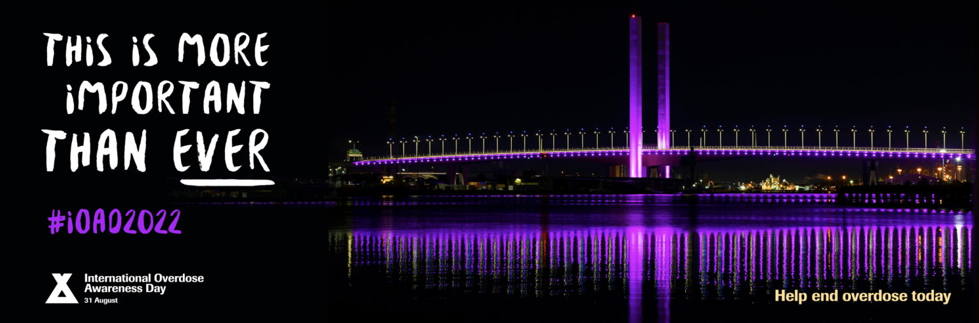
International Overdose Awareness Day: August 31st
https://www.overdoseday.com/campaign-resources/

Slide 23
Grants Management System
What is it?
DAODAS Grants Management System (GMS) is a web-based, software-as-a-service solution that supports the entire grant lifecycle workflow from pre-qualification, solicitation, proposals, award, contract, invoice, reporting, monitoring and closure.
Why?
The system is an essential technology component of embedding digital capabilities within DAODAS, as part of the state agency’s continuing digital transformation.
What is the impact on County Authorities?
The GMS is a project management tool. The County Authorities will be able to see DAODAS funding/program announcements; communicate needs assessment; submit applications; receive award offers; document and store contracts; set and manage goals, objectives, track activities, performance; update performance metrics; allocate and track budget and accounting; request disbursement, drawdown, reimbursement; submit cost/expense documents; request carryovers, extensions/renewals; view/print reports and manage closeouts.

Slide 24
Grants Management System
Three Components of new DAODAS Grant Management System
Pre-Award (DAODAS Grant Application Portal): Training has been provided
  Applications will be posted and completed for review. Each agency that completed the MAT application should have an agency login for completing future applications.
  DAODAS will gradually be utilizing the pre-award site for new funding opportunities such as the new SOR that we anticipate receiving in October.
  If funded, application components move over to post-award to include goals, objectives, performance measures and budgets. This is what DAODAS is currently populating for each county from the County Plan.
Post-Award (GrantVantage): Training is scheduled-webinars held August 10-17
  Grant reporting on accomplishments, reimbursement requests and responding to deliverables outlined in the contact will be monitored in the GrantVantage platform.
  Licenses are required, therefore each agency will receive 4/5 logins that will be assigned to key staff. (Dynamics Users)
Data Collection (DAODAS Portal): Overview today- training to follow based on input from field
  Prevention Service data will be entered into the portal
  Portal will connect to Performance measures, objectives and goals in GrantVantage
  Reports are in development and will be completed this fall

Slide 25
Pre-Award
Brief Overview

Slide 26
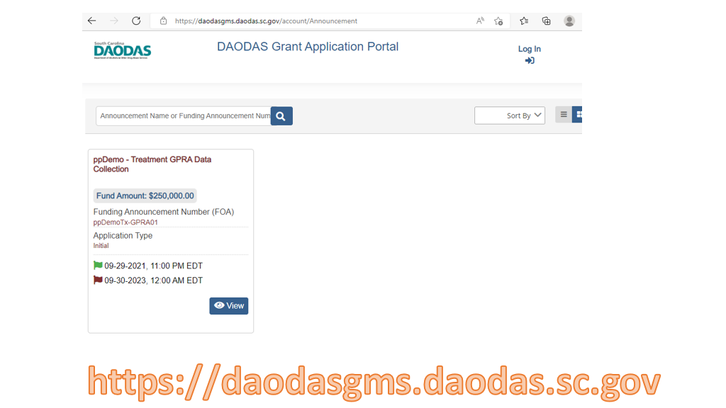
Grants Management System

Slide 27
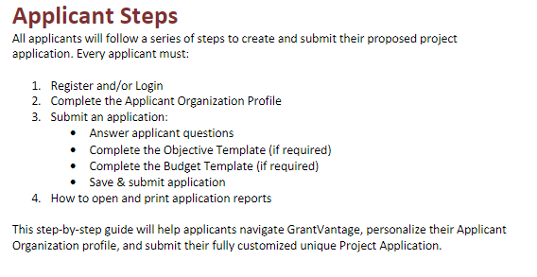

Slide 28
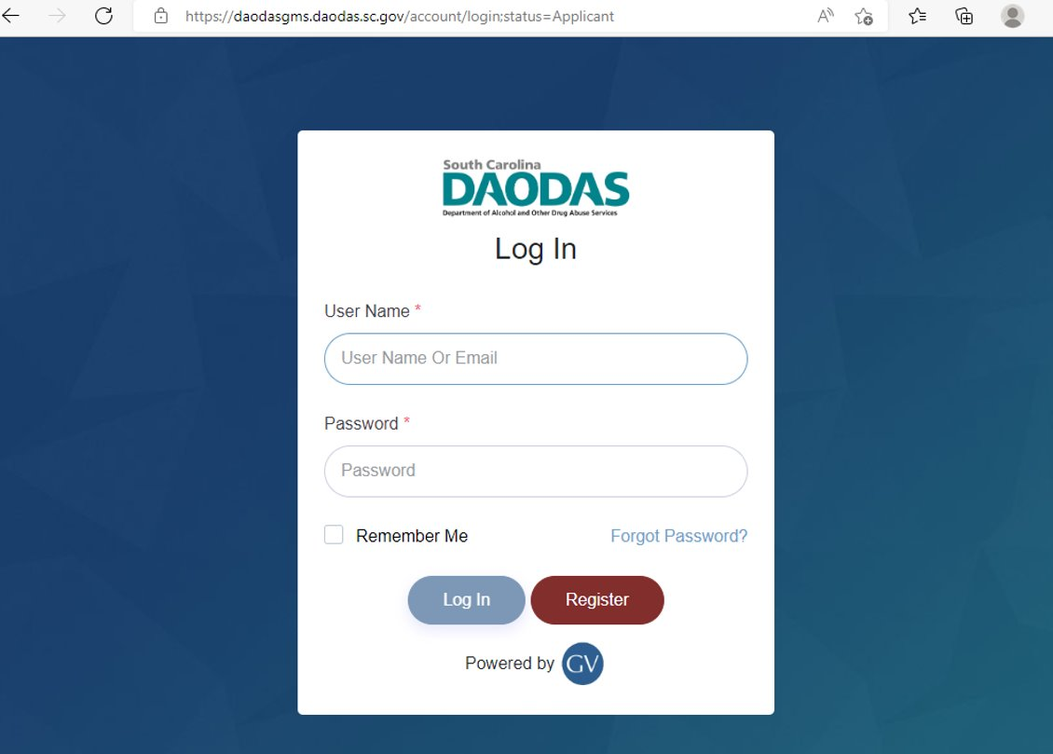

Slide 29
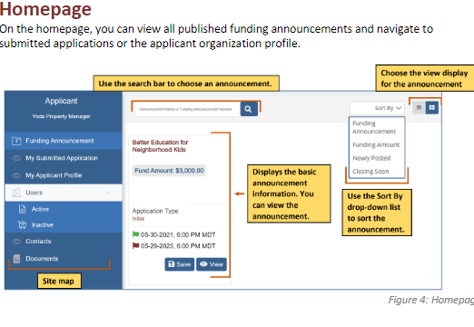

Slide 30
Post-Award
Brief Overview

Slide 31
Supported Browsers
The following browsers are supported for using Microsoft Dynamics 365 in the cloud:
Google Chrome
Microsoft Edge
Apple Safari
NOTE: Internet Explorer is not supported for Microsoft Dynamics 365.

Slide 32
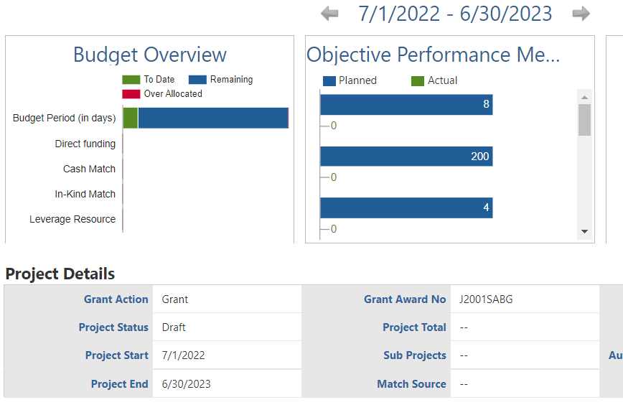

Slide 33
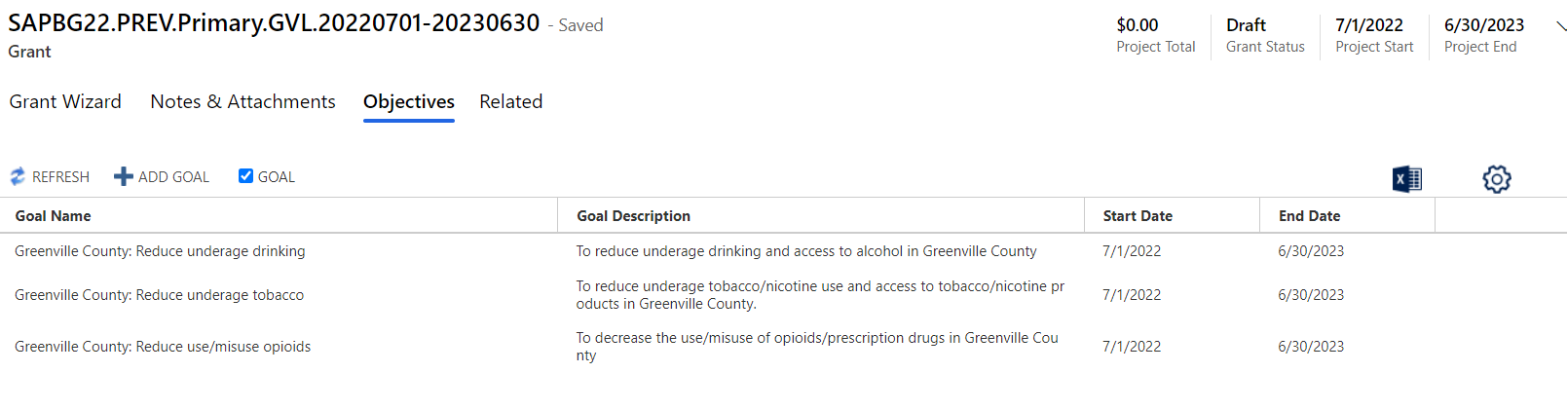

Slide 34
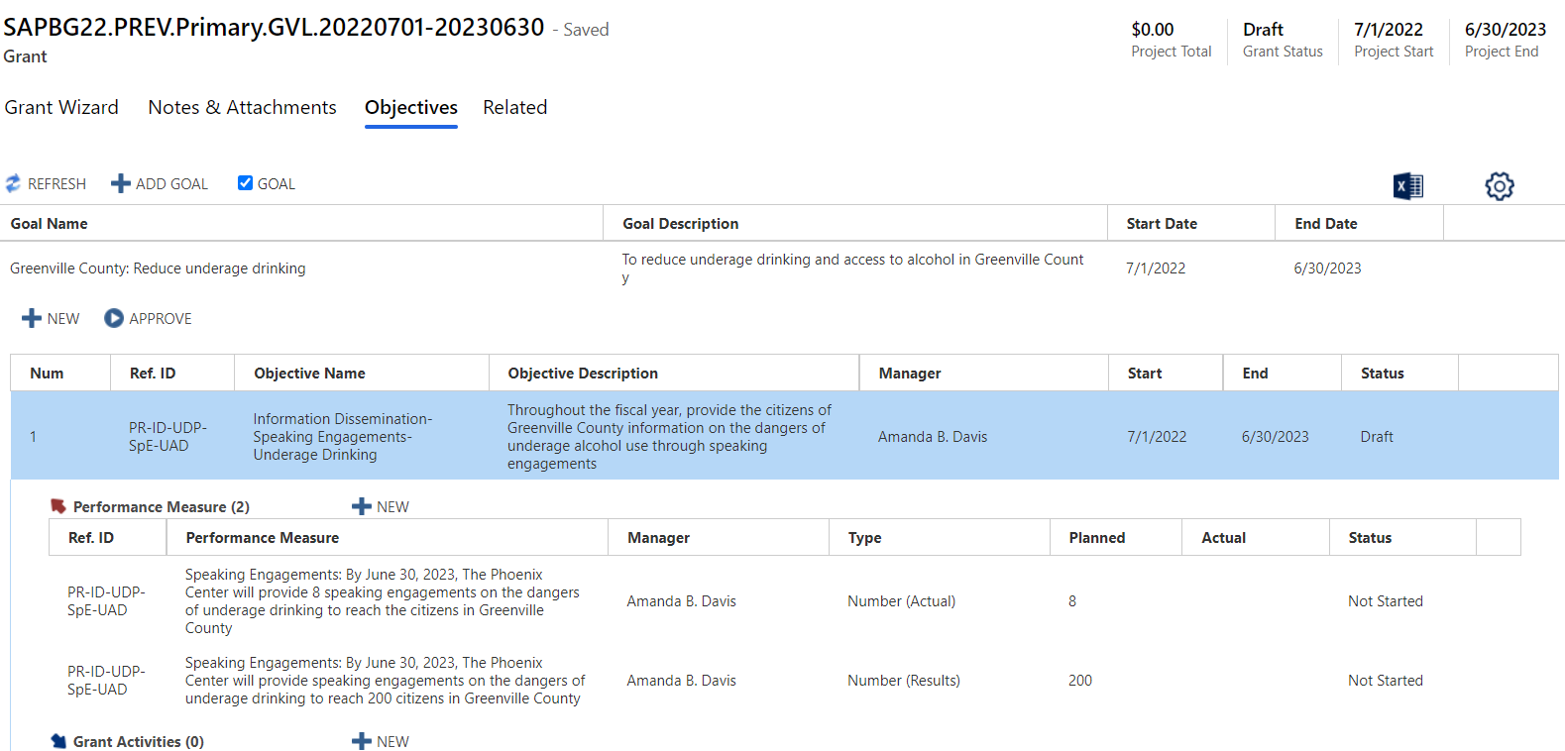

Slide 35
GrantVantage Interface with
Data Collection Portal
Brief Overview

Slide 36
The DAODAS Portal solution is accessible from the DAODAS Portal change area of the GrantVantage
application. This area contains entities, forms, and views that are designed to support Portal Submissions.

Slide 37
The Portal Solution is comprised of the following entities:
Portal Submissions
Participants
Demographics
Counties
Portal Submissions
The Portal Submissions entity contains records of online forms submitted by authorized users who are facilitating events and activities as required by grants awarded to the portal user’s organization.
Submissions capture details related to the event or activity including but not limited to date and time, location, organization, and demographics of the participants in attendance.
Each time a form is submitted, a record of the form is created in the Portal Submissions entity.
Dynamics users are able view the data by clicking on the Submission ID (primary attribute of each record), which opens the form.

Slide 38
The Portal Solution is comprised of the following entities:
Portal Submissions
Participants
Demographics
Counties
Participants
The Participants entity tracks records of Staff Member and Volunteer participation for all Portal Submissions, including time spent planning and facilitating the event or activity. When a form is submitted via the portal, a record is created in the Participants entity. The record is also appended to the Portal Submission record in a sub-grid for quick access.

Slide 39
The Portal Solution is comprised of the following entities:
Portal Submissions
Participants
Demographics
Counties
Demographics
The Demographics entity is used to capture the Age, Race, Gender, and Ethnicity of citizens who attend the Educational events or activities facilitated by the portal user. Since an Educational event or activity can be comprised of multiple sessions, this entity supports the portal user entering the demographics for each session.

Slide 40
The Portal Solution is comprised of the following entities:
Portal Submissions
Participants
Demographics
Counties
Counties
The Counties entity contains a list of all 46 counties in South Carolina along with each county’s jurisdiction and the designated AET Coordinator. This list is used to assign counties to portal users indicate the county in which the event or activity occurred.

Slide 41
GrantVantage Integration
When a form is submitted via the portal, a workflow on the backend is triggered to validate the
Metric Increment R set on the Performance Measure selected for the submission. The workflow
increments the Actual based on the rule. The Metric Increment Rule options include:
• Increment By Handout – Adds the number of Handouts indicated on the submitted form to the
Actual amount.
• Increment by Views– Adds the Count of Views indicated on the submitted form to the Actual
amount.
• Increment by One – Adds the submission as a count of One to the Actual amount.
• Increment By Total Served – Adds the Total Number Served indicated on the submitted form to
the Actual amount.

Slide 42
Using the example in the screenshot, the total number of citizens/participants served as of the
submission of the form is 56 out of a planned 1200.

Slide 43
Data Collection Portal
Brief Overview

Slide 44
Platforms
The most recent version of iOS is recommended to run Power Apps for mobile devices, noting the previous version meets the minimum required.
Browsers
The following browsers are supported for using Microsoft Power Apps portals:
Google Chrome
Microsoft Edge
Mozilla Firefox
Apple Safari
NOTE: Internet Explorer is not supported for Microsoft Power Apps portals.

Slide 45
Operating Systems
The operating systems listed below are supported for running Microsoft Power Apps portals.
Windows 10 or later
macOS 10.13 or later
iOS 13 or later
Android 10 or later
Access
Access to the DAODAS Portal is granted one of two ways:
1. Via Portal Invitation triggered from the Dynamics 365 GrantVantage application
2. Via Self-Registration

Slide 46
Portal Invitation User Experience
The DAODAS Prevention team will trigger the invitation which sends an email to the user. The recipient will click on the URL in the email invitation to navigate to the portal.

Slide 48
Self-Registration User Experience
On the DAODAS Portal Home page, click Sign in.
Click on the Register tab.
Complete the registration information under “Register for a new local account,” and then click the Register button. The Profile screen displays.
Complete the required fields under Register for a new local account, and then click the Register button. The Profile screen displays.
An email is sent to DAODAS Prevention team to set up the user. Upon completion of the set-up, the DAODAS Prevention team will notify the user that the registration process is complete.

Slide 49
Navigation
The DAODAS Portal is comprised of a Home Page, Forms library, and a My Forms view. Users must complete the portal registration process and be signed in to access each page. The sections below offer an overview and/or functionality of each page.
Home Page
The Home Page offers information about the portal, including instructions and important dates
Forms
The Forms library includes forms grouped by strategy. By default, strategies are collapsed. Clicking the drop down next to a strategy displays the related forms.
Clicking on a form launches the form detail. Each form contains a series of fields for reporting on an event or activity. The top section in each form contains fields that display a list of options that are filtered based on the authenticated user’s set-up in Dynamics 365 (D365), which is managed by the DAODAS Prevention team.
The Organization field displays only those organizations to which the authenticated user is assigned in D365.

Slide 50
Similarly, the County field displays counties assigned to the authenticated user’s contact record in D365.
The Grant, Objective, and Performance Measure fields are configured with cascading logic to simplify the user’s selections.
• The Grant field displays a list of Grants assigned to the Organization.
• The Objective field displays Objectives associated with the Grant.
• The Performance Measure displays only those Performance Measures associated with the Objective.
Event Date and Time
The Date and Time field is required. This field is used to document the date and time the event or activity occurred. Clicking the calendar widget presents a calendar to select the date. The current date is set as the default.

Slide 51
Staff Members and Volunteers
Each form contains a section for indicating the Staff Members and Volunteers that contributed to the event or activity. This section is comprised of a sub-form, which is enabled upon clicking the Save button at the bottom of the form.
Clicking the Create button for Staff Members displays the sub-form. Only one member can be added at a time. Select the member, and then click Select.
Enter the Direct and Indirect time and click Save. The Total Hours and Total Minutes are automatically calculated.
NOTE: If Hours are entered for Direct or for Indirect, then the related Minutes field must be completed, and vice versa. Entering ‘0’ is an acceptable value.
Clicking Save records the staff member on the form. Click Create again to add the next staff member, if applicable.

Slide 52
The Volunteers sub-form works similar to the Staff Members sub-form. Clicking the Create button opens the sub-form. Use the Volunteer Type field to indicate the type of volunteer that contributed to the event or activity.
The Volunteer ID is used to indicate the unique identifier used by the volunteer. While optional for submission, it is recommended that the identifier be entered when Volunteer Type = Volunteer ID.
Use the Direct and/or Indirect time entry fields to record the volunteer’s time.
Clicking Save records the volunteer on the form. Click Create again to add the next volunteer, if applicable.
Demographics
Several forms capture demographics: Age, Gender, Race, and Ethnicity of the participants. The total count entered for each demographic (section) must equal the Total Number Served. An error displays when the total count per demographic and Total Number Served do not match.

Slide 53
The Educational forms also contain a Demographics section as a sub-form. This form is enabled the first time the Educational form is saved.
Clicking Create opens the sub-form for recording the demographics specific to a Group/Session Date. The Headcount serves as the point of validation for demographic counts per section. If the counts for each demographic do not equal the Headcount, an error message is displayed.
Clicking Save on the demographic sub-form records the session details on the primary form. Click Create to add another session.
Use the Total Number Served field on the Educational form is used to indicate the number of participants in the session with the highest headcount.

Slide 54
Form Submission Statuses
The Save button at the bottom of the form has two (3) functions.
1. Clicking Save the first time enables sub-forms to display, such as Staff Members and Volunteers (for all forms) and a Demographics sub-form (for Educational forms).
Clicking Save a second time without checking the ‘confirm’ checkbox saves the form in a Draft status. The form can be opened from the My Forms page to make changes
Clicking Save with the confirm statement checked sets the form to a Submitted status. A form cannot be altered after it has been submitted. To make modifications to a submitted form, contact the DAODAS Prevention team.

Slide 55
Attachments
The Upload Files feature on the forms listed below allows the portal user to attach multiple documents to a submission.

Slide 56
My Forms
The My Forms page displays a list of forms initiated or submitted by the authenticated user. By default, the form submissions are sorted by Submitted Date in descending order. Clicking on a column name changes the list sort order in ascending order based on the values in that column. Clicking the column name again sorts the list in descending order.
The Submitted Date is the primary attribute (hyperlink) for each submission. Clicking on the date/time opens the form in its last saved state.
• Forms with a Submitted Status of Draft will open in Edit mode and can be updated prior to submission.
• Forms with a Submitted Status of Submitted will open in Read Only mode.
NOTE: To make modifications to a submitted form, contact the DAODAS Prevention team.

Slide 57
Demonstration and Next Steps

Slide 58

1801 Main Street, 4th Floor • Columbia, South Carolina 29201
telephone: 803-896-5555 • fax: 803-896-5558
www.daodas.sc.gov
Notes:
Final Slide

